Slide 1
Bstack demo website
Under Guidance of Mrs. Vaishali Sonanis Mam.
BY KAVALI VENKATA SAI SRI KARTHIK

Slide 2
Introduction :
BrowserStack is a website that helps software developers and testers check if websites and apps work correctly on many different devices and browsers.

Slide 3
Members of Team
KAVALI VENKATA SAI SRI KARTHIK – TEST LEAD

Slide 4
Responsibilities
Structured all modules for better organization.
Designed, reviewed and optimized all test cases.
Executed all test cases thoroughly.
Created a detailed defect report and tracked issues until closure.

Slide 5
Overview
What is Bstack demo?
bstack demo website is a practice site made by BrowserStack for testers and developers.
It looks like a regular online shop, so users can test things like searching for products, logging in, adding to cart, and placing orders

Slide 6
Modules
Module 1 : login page
Checked all the functionalities on login page wheather user is able to login into the website using valid credintials
Module 2 : Search product
. To verify search button is working or not for customer requirements
Module 3 : add to cart page
Checked all the functionalities on home page which included item details, Quantity, Add to cart button, product info,grid,list button.
Notes:
Module 1: Signn in page
Checked all the functionalities on Sign in page which included personal info as email
address, password
Module 2: Women page
Checked all the functionalities on Women page which included item details, Quantity, Filters,compare button,Add to cart button,product info,grid,list button
Module 3: Tshirt page
Checked all the functionalities on T-Shirt page which included item details, Quantity, Filters,compare button,Add to cart button,product info,grid,list button
Module 4: All Buttons and Drop Down Arrow :
team checked if all the buttons and drop down arrows of different fields are functioning properly or not

Slide 7
Module 4 : offers
After applying an offer or coupon code, check if the discount is applied correctly to the total amount.
Module 5 : orders
After placing an order check if the order is successfully added into the orders
Module 6 : order by
After applying the sort check if the product list is rearranged according to the selected sorting rule.
Module 7 : favourites
After clicking product into favourites verify that the product is added to the favourites list

Slide 8
Module 8 : delete from cart
After removing the product from the cart, check if the product is successfully removed or not..
Module 9 : checkoutpage
Confirm that delivery address fields accept valid input and provide error messages for invalid data.
Module 10 : logout
Verify that the user is successfully logged out and redirected to the home page.
.

Slide 9
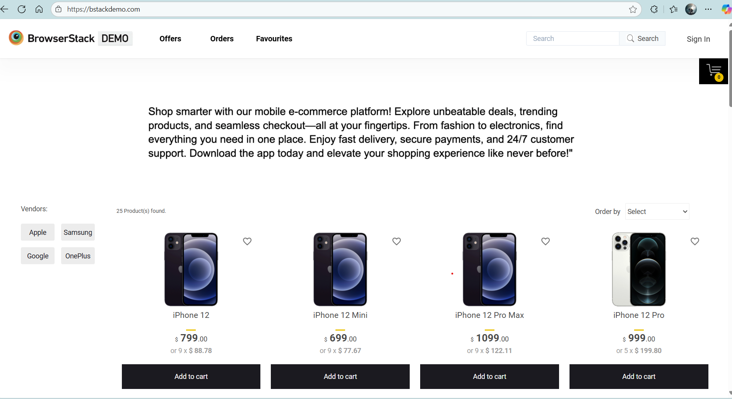

Slide 10
Defects
While running a testcase at certain point some fields are not working as it is expected which is nothing but a defect, so I have created a Defect report on those defects.

Slide 11
Defect identifier :- lg_01
Defect summary :- USER SHOULD BE ABLE TO SIGN IN MULTIPLE TIMES
Ø Test Id :- tcl-007
Ø Test case name :- TCL_login_multiple_attempts
Ø Module name :- login
Ø Reproducible :-
Ø Severity :- medium
Ø Priority :- medium
Ø Raised by :- kavali Venkata sai sri karthik
Ø Assigned to :- developer Team lead
Ø Date of assignment :- 0109/2025
Ø Status :- pending
Ø Snap shots :-
Ø Fixed by :- developer
Ø Date of fixing :-

Slide 12
Defect identifier :- lg-02
Defect summary :- Check and verify all usernames are working or not.
Ø Test Id :- TCL-008
Ø Test case name :- TCL_use_all_usernames
Ø Module name :- login
Ø Reproducible :-
Ø Severity :- medium
Ø Priority :- medium
Ø Raised by :- kavali Venkata sai sri karthik
Ø Assigned to :- developer Team lead
Ø Date of assignment :- 01/09/2025
Ø Status :- pending
Ø Snap shots :-
Ø Fixed by :- developer
Ø Date of fixing :-

Slide 13
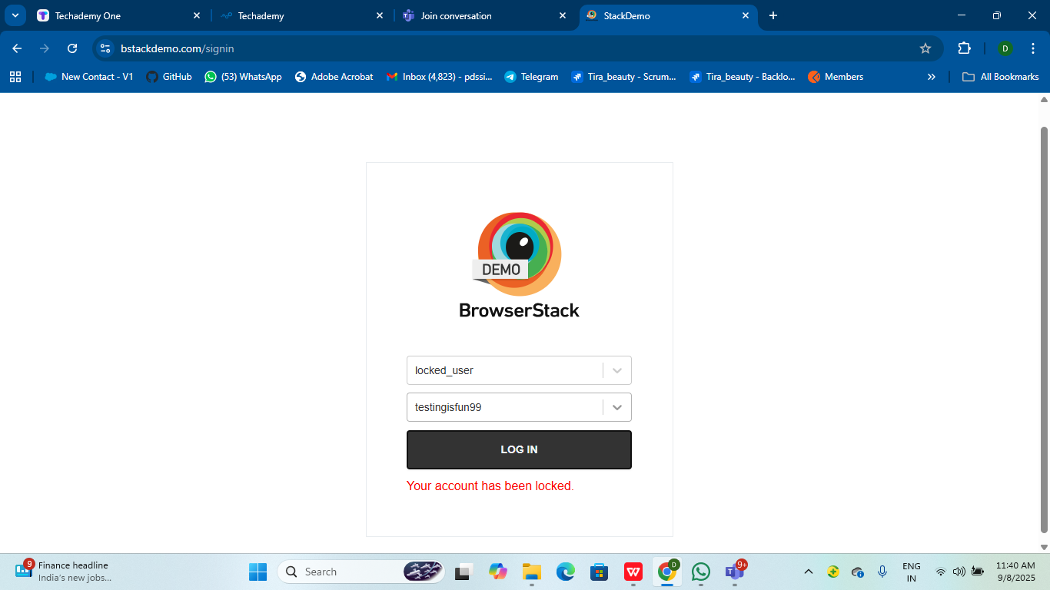

Slide 14
Challenges
If you run automated scripts too fast, eBay may flag you as a bot and block your account or IP.
While testing website we faced some challenges about:
if you run automated scripts too fast, bstack may not run and stop the execution because the website and the data is dynamic in nature.
In order to do automation finding locators of this website become a task. There are many locators are not working as expected. Finding all these locators and doing automation becomes challenging.

Slide 15
Experience
Because of lot of communication And discussion with our mentor vaishali madam it helps me to write taste case in easy way.
I feel exited to work for this project and learn lot of new things during the process and gained hands on experience by doing this project.
Using automation scripts and using frameworks like testng, cucumber and tools like jenkins make easier for handling projects like bstack.
Manual testing needs strong observation and in that testers needs to apply all possibilities in test cases.

Slide 16
Thank You!!!
Vaishali Mam For Guiding Us through out the Project.

